Slide 1
Broadband usage CW-E
Group 10

Slide 2
Team Members
Anil kakkar
Gagandeep kaur Heera
Vijay Khanna
Kartik
Kanishka Singh
GitHub link:
https://github.com/AnilKakkar76/CapstoneProject_CW-E Git hub

Slide 3
Contents
Problem Statement
Research Questions / Objectives
Analytical Goals
Dataset
Preprocessing data
Data Analyzation and Visualization
Summary of findings
Plan for real data (NEXT STEP)
References

Slide 4
Problem statement
Access to high-quality broadband services is critical for effective teaching and learning in schools. Various school boards in Southwestern Ontario are increasingly reliant on broadband services for online learning, research, and communication. However, there is a lack of understanding of broadband quality and usage in local schools, hindering the ability of schools to provide optimal learning experiences for students.
This project aims to analyze broadband usage and quality in local schools to provide insights on the strengths and weaknesses of the current broadband services and make recommendations for improvements.

Slide 5
Goals and objectives
Analysis of broadband quality
Analysis of broadband speed
Comparisons between carriers at the same location
Comparison between different technologies(i.e. fibre, coax, cellular , satellite)
Comparisons between different sites with same carriers/technology
Analysis of external factors (i.e. weather) on the internet services.

Slide 6






Analytical Goal
Determine Data Variables and Develop Analytic Framework
Evaluate the results
Draw conclusion and make recommendations
Define Problem and Research Questions
Conduct the analysis

Slide 7
Dataset and Its Sources
Survey Data Collected from Students
https://forms.office.com/Pages/ResponsePage.aspx?id=b2eGyTmbCE20-KZo4OjGpalrCxjr7-9BqM097lxqcNRUN1MzVzlVNU4wR0JNUkRKOUNWUlhJUzY2Ri4u
Ookla sample Data set
https://www.kaggle.com/datasets/dhruvildave/ookla-internet-speed-dataset
Sample Data sets Provided By CW-E
IPT-results-2023-02-13-101322
Summary Report 2023-01-01 - 2023-02-01

Slide 8
Data assessment
Although we have yet to obtain actual data, we can still conduct a data assessment using sample data. This sample data exhibits similarities to the real data we anticipate acquiring from CW-E, thus allowing for meaningful analysis and evaluation.
STEPS INVOLVING IN DATA ASSESSMENT
Data Quality Check
Data Sampling
Data Validation

Slide 9
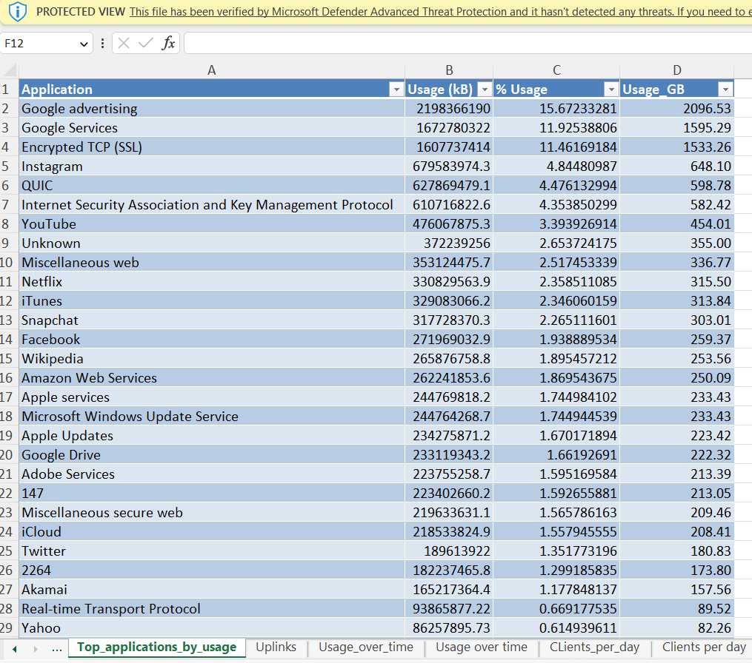
Data Quality Check
It is important to ensure that the data is of high quality and free from errors. This can be done through data profiling, where we check data for
Completeness
Consistency
Accuracy
Validity

Slide 10
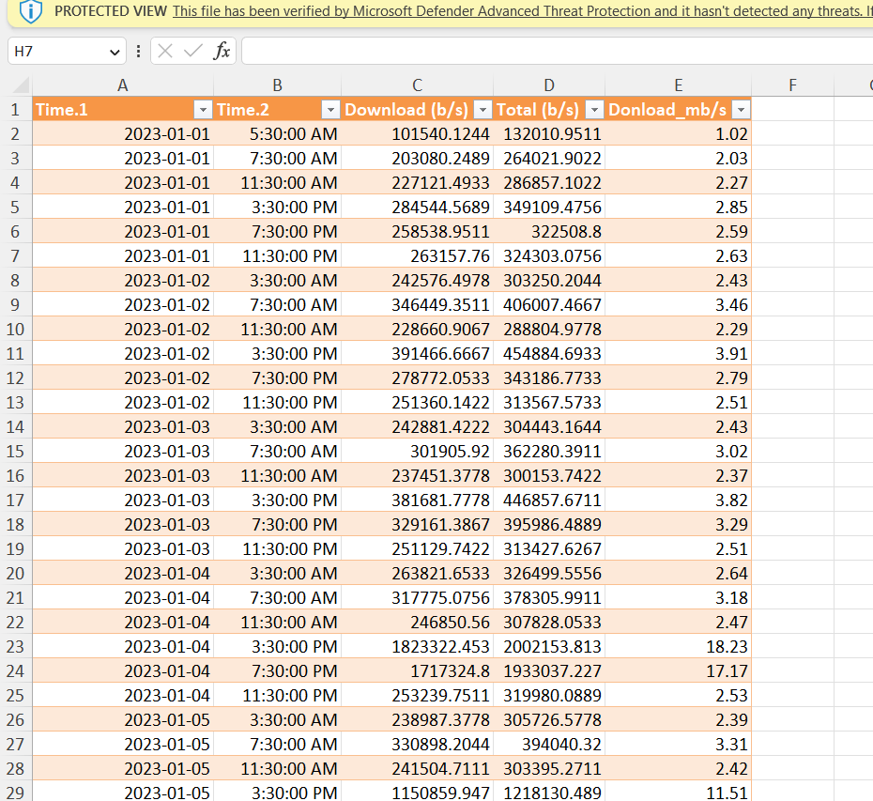
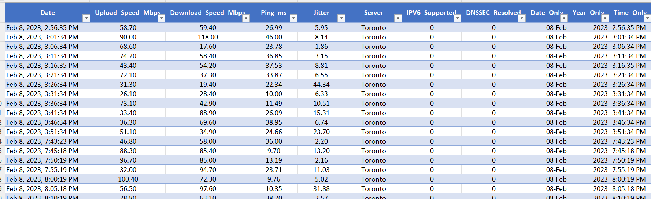
Checking each columns in Data for Quality Check

Slide 11
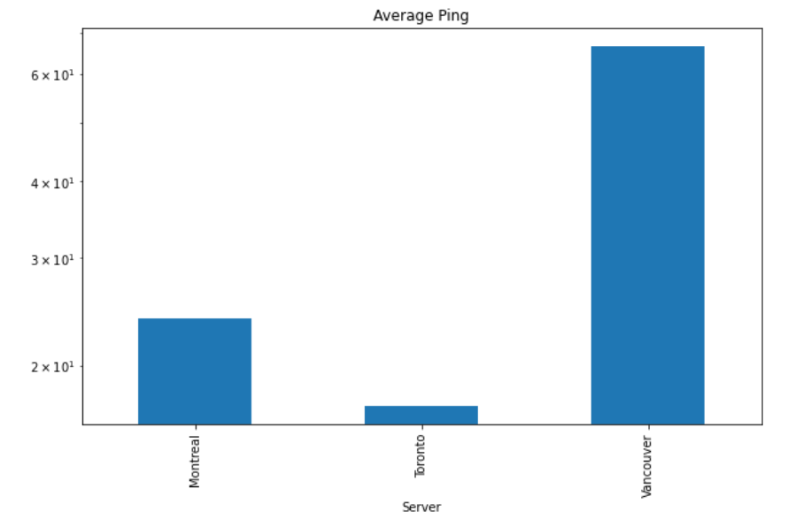
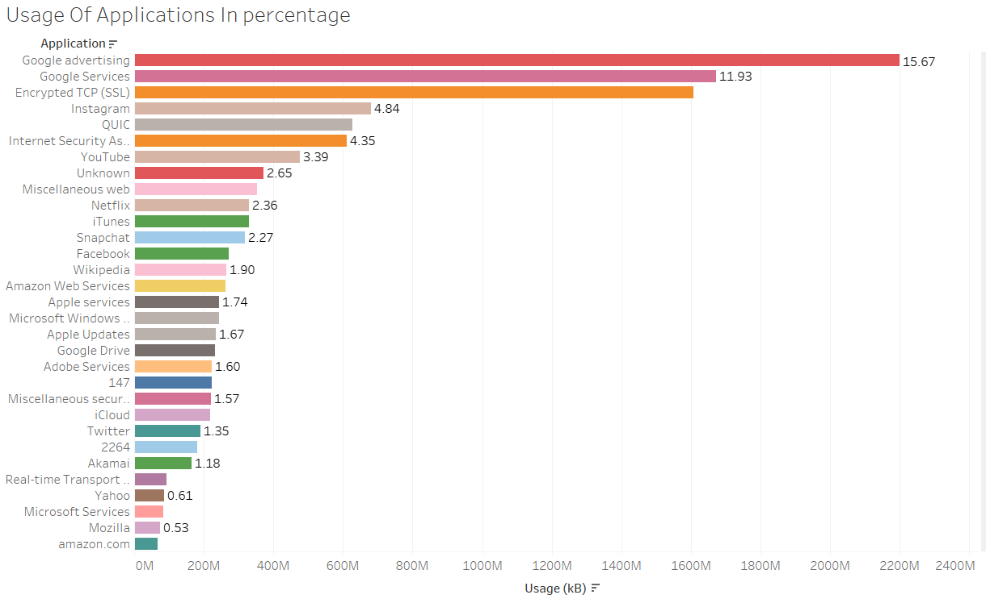
Data Sampling
Although Our Sample data is not to large still we perform specific tasks with data to draw conclusion about data sets such as analyzing data with specific variables in Tableau, Python and Excel.

Slide 12
Data Validation
Upon conducting a rough analysis and implementing specific data preprocessing steps, we have determined that the data is free from errors and contains variables and columns that can be leveraged for analytical techniques in support of the project objectives.
However, it should be noted that certain variables are lacking, thereby rendering a comparison between different technologies, such as fiber, cellular, and satellite, and carriers, unfeasible at present.
We talked about this with CW-E in meeting

Slide 13
Preprocessing
In Data preprocessing we go through several steps which are
Mentioned below:
Cleaning
Transforming
Preparing data for further analysis

Slide 14
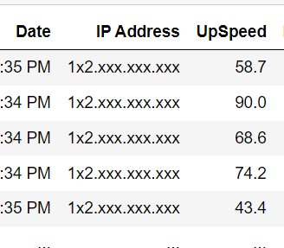
Cleaning
During the data cleaning process, we typically address missing values, duplicates, and outliers. In the case of the given dataset, we have identified columns that contain zero values or information that is deemed irrelevant to our analysis. In order to address this, we have opted to drop these columns from the dataset.

Slide 15
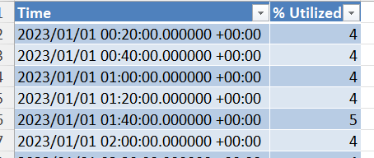
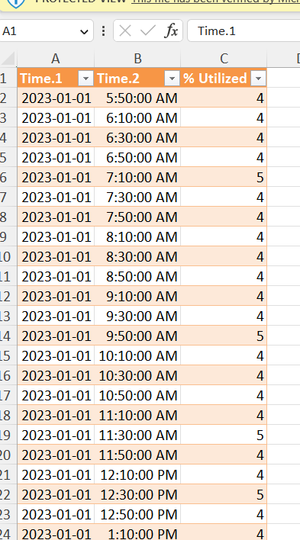
Transforming & Preparing data for further analysis
Transform combine column of Date time into separate columns.
Convert Usage of application in KB into GB.
Several more small task to prepare data for further analyzation

Slide 16
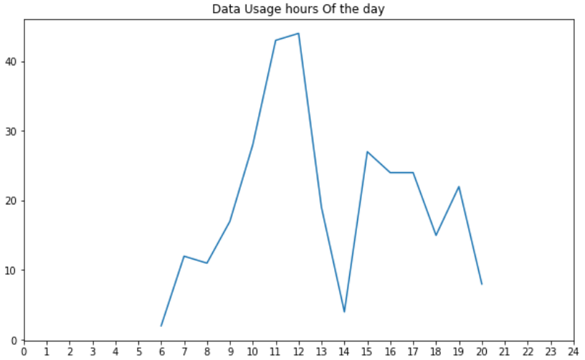
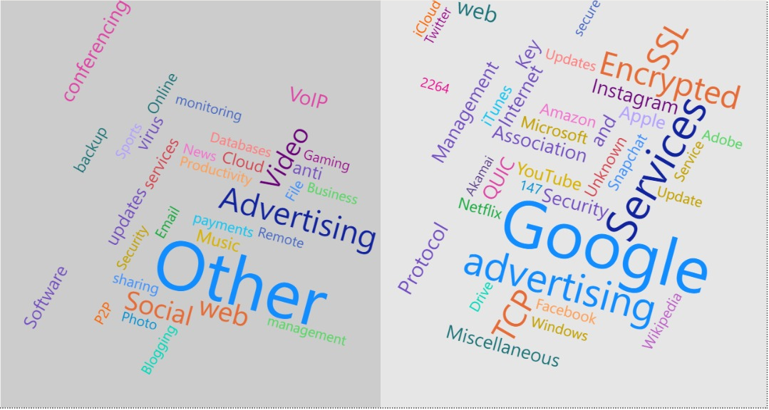
Data Analyzation and Visualization
As a Group we analyzed both data set in several platform such as tableau, python (Jupyter), Power Bi or in Excel.

Slide 17
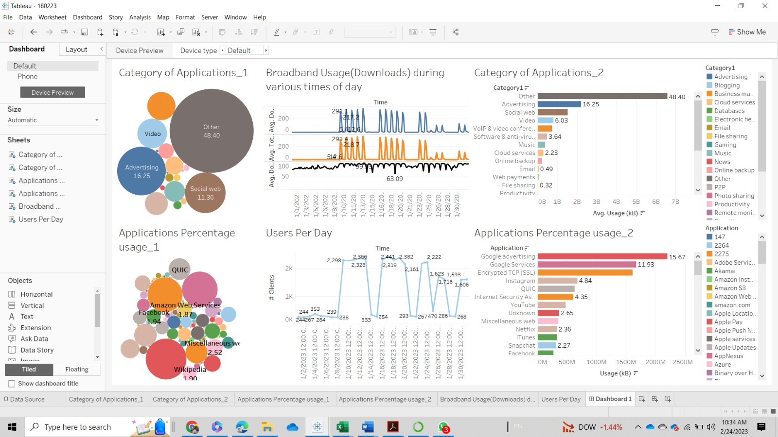
Dashboards

Slide 18
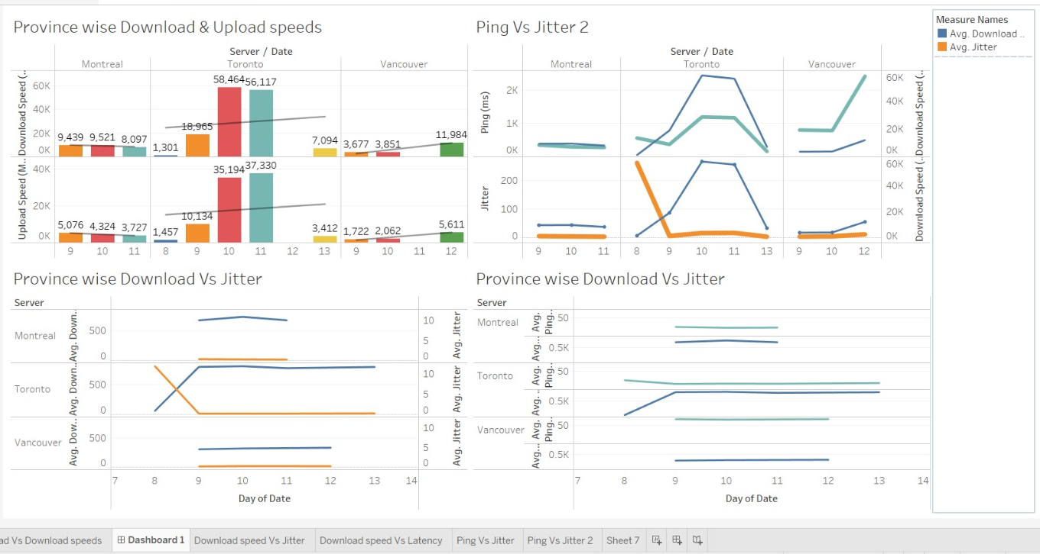

Slide 19
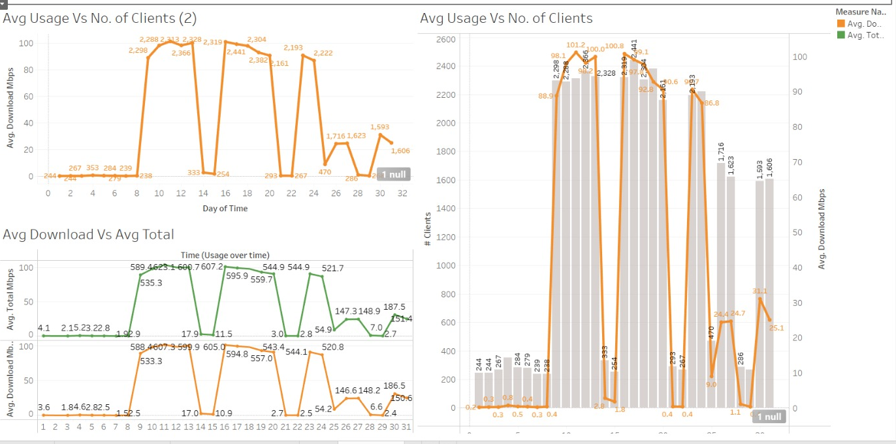

Slide 20
Summary of findings
Compared to other applications, Google advertising is known to consume a significantly larger amount of data.
The user count during weekdays is higher in comparison to weekends.
During peak hours, when the number of connected devices increases, there is a decline in both upload and download speeds.
The Vancouver server tends to have a higher average ping, while the Toronto server experiences higher jitter. On the other hand, the Montreal server has a normal ping and jitter compared to the other two servers.

Slide 21
Timeline & Plan for Next Steps
Deploy strategic networks with compelling e-business needs
Sep 20XX
Synergize scalable e-commerce
Nov 20XX
Disseminate standardized metrics
Jan 20XX
Coordinate e-business applications
March 20XX
Foster holistically superior methodologies
May 20XX

Slide 22
Areas of focus

Slide 23
References

Slide 24
Summary
At Contoso, we believe in giving 110%. By using our next-generation data architecture, we help organizations virtually manage agile workflows. We thrive because of our market knowledge and great team behind our product. As our CEO says, "Efficiencies will come from proactively transforming how we do business."

Slide 25
Thank you
Group 10

